Slide 1

8th Grade Math: Pre-Algebra
Unit 8, Lesson 5 Solving Real-World Equations with Variables on Both Sides Volume 2, pg. 26

Slide 2


Benchmark
MA.8.AR.2.1
Solve multi-step linear equations in one variable, with rational number coefficients. Include equations with variables on both sides.
volume 2, pg. 26

Slide 3
Integrated Mathematical Thinking and Reasoning Standards
MA.K12.MTR.1.1 Actively participate in effortful learning both individually and collectively.
MA.K12.MTR.6.1 Assess the reasonableness of solutions.
MA.K12.MTR.7.1 Apply mathematics to real-world contexts.
volume 2, pg. 26

Slide 4

Learning Target
I can solve equations with variables on both sides in a real-world context.
volume 2, pg. 26

Slide 5

Warm-Up
volume 2, pg. 26

Slide 6
8.5.1 Warm-Up: Mistakes are Learning Opportunities
Describe a time in your life when you made a mistake, but it was a good thing because you were able to learn from that mistake.
How does making mistakes when solving math problems help you?
volume 2, pg. 26

Slide 7

Exploration
volume 2, pg. 27

Slide 8

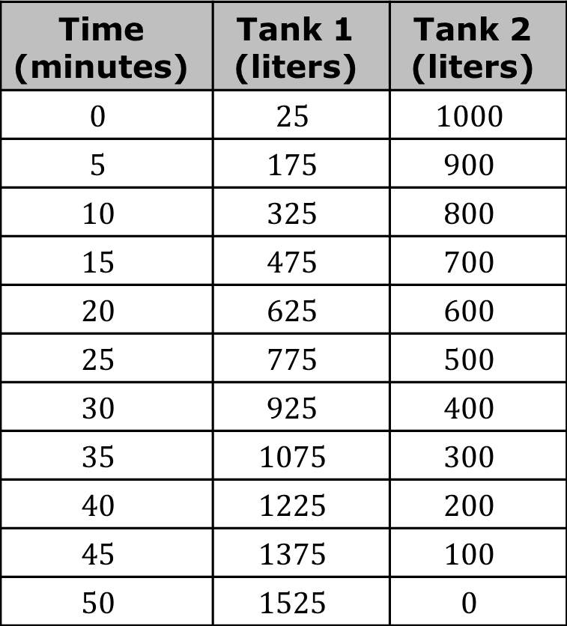
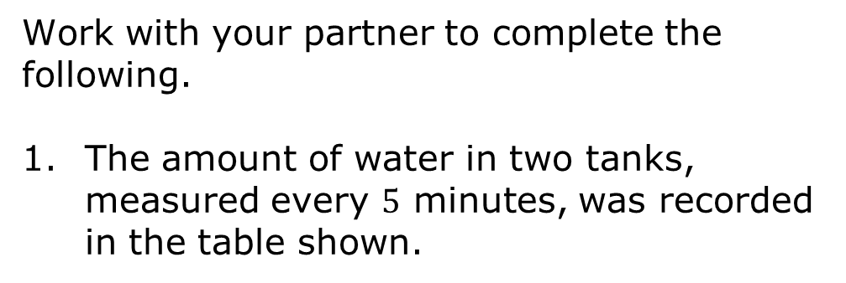
8.5.2 Exploration: Water Tanks
Work with your partner to complete the following.
The amount of water in two tanks, measured every $5$ minutes, was recorded in the table shown.
Time (minutes) | Tank 1 (liters) | Tank 2 (liters)
$$0$$ | $$25$$ | $$1000$$
$$5$$ | $$175$$ | $$900$$
$$10$$ | $$325$$ | $$800$$
$$15$$ | $$475$$ | $$700$$
$$20$$ | $$625$$ | $$600$$
$$25$$ | $$775$$ | $$500$$
$$30$$ | $$925$$ | $$400$$
$$35$$ | $$1075$$ | $$300$$
$$40$$ | $$1225$$ | $$200$$
$$45$$ | $$1375$$ | $$100$$
$$50$$ | $$1525$$ | $$0$$
volume 2, pg. 27

Slide 9
Review the table with your partner and describe the changes in water levels for each tank over time.
Based on the table, predict the approximate number of minutes after which the tanks will reach the same water level.
Estimate the amount of water in each tank when their levels are the same.
Tank 1
Tank 2
volume 2, pg. 27

Slide 10
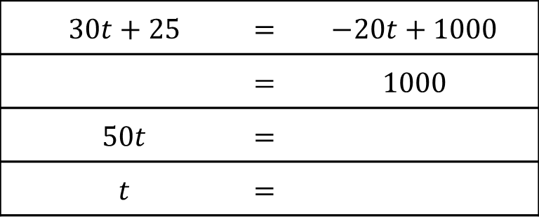
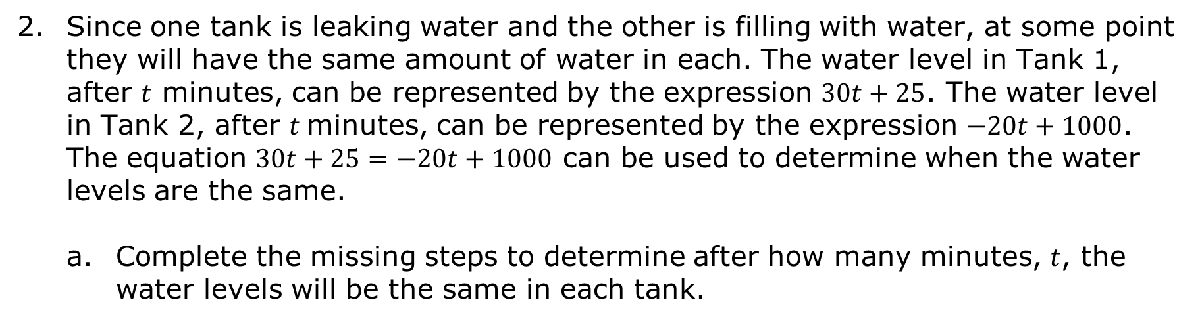
Since one tank is leaking water and the other is filling with water, at some point they will have the same amount of water in each. The water level in Tank 1, after $t$ minutes, can be represented by the expression $30t+25$. The water level in Tank 2, after $t$minutes, can be represented by the expression $−20t+1000$. The equation $30t+25=−20t+1000$ can be used to determine when the water levels are the same.
Complete the missing steps to determine after how many minutes, $t$, the water levels will be the same in each tank.
$$30t+25$$ | = | $$−20t+1000$$
 | = | $$1000$$
$$50t$$ | =
$$t$$ | =
volume 2, pg. 27

Slide 11
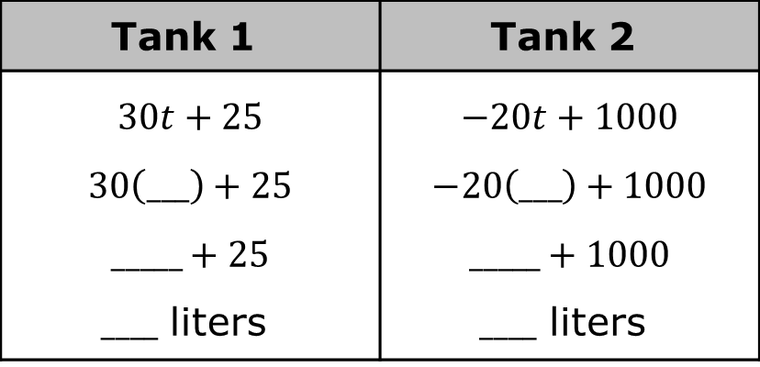
Use the solution to complete the missing steps to determine how many liters of water were in each tank when their levels were the same.
Compare your estimates to the actual calculated times and water levels when the tanks contained the same amount of water.
Which estimates were the closest, yours or your partner’s?
Tank 1 | Tank 2
$$30t+25$$ $$30\left(___\right)+25$$ $$_____+25$$ $____$ liters | $$−20t+1000$$ $$−20\left(___\right)+1000$$ $$_____+1000$$ $____$ liters
volume 2, pg. 28

Slide 12

Guided Instruction
volume 2, pg. 28

Slide 13
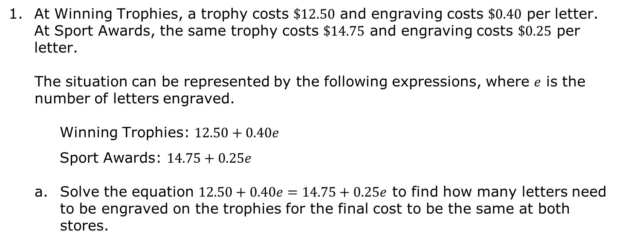
8.5.3 Guided Instruction: Solving Real-World Equations with Variables on Both Sides
At Winning Trophies, a trophy costs $\$12.50$ and engraving costs $\$0.40$ per letter. At Sport Awards, the same trophy costs $\$14.75$ and engraving costs $\$0.25$ per letter.
The situation can be represented by the following expressions, where $e$ is the number of letters engraved.
Winning Trophies: $12.50+0.40e$
Sport Awards: $14.75+0.25e$
Solve the equation $12.50+0.40e=14.75+0.25e$ to find how many letters need to be engraved on the trophies for the final cost to be the same at both stores.
volume 2, pg. 28

Slide 14
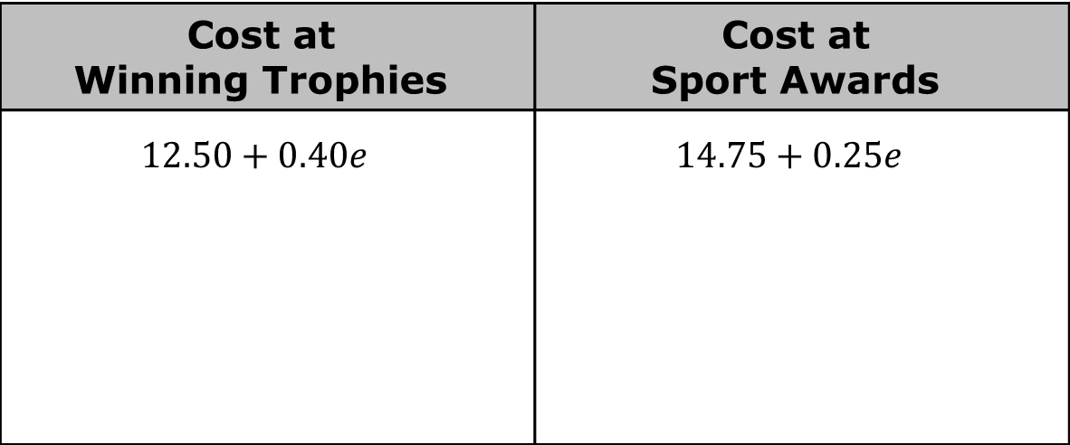
Check your work by determining the final cost for the trophy at either store.
Cost at Winning Trophies | Cost at Sport Awards
$$12.50+0.40e$$ | $$14.75+0.25e$$
volume 2, pg. 28

Slide 15
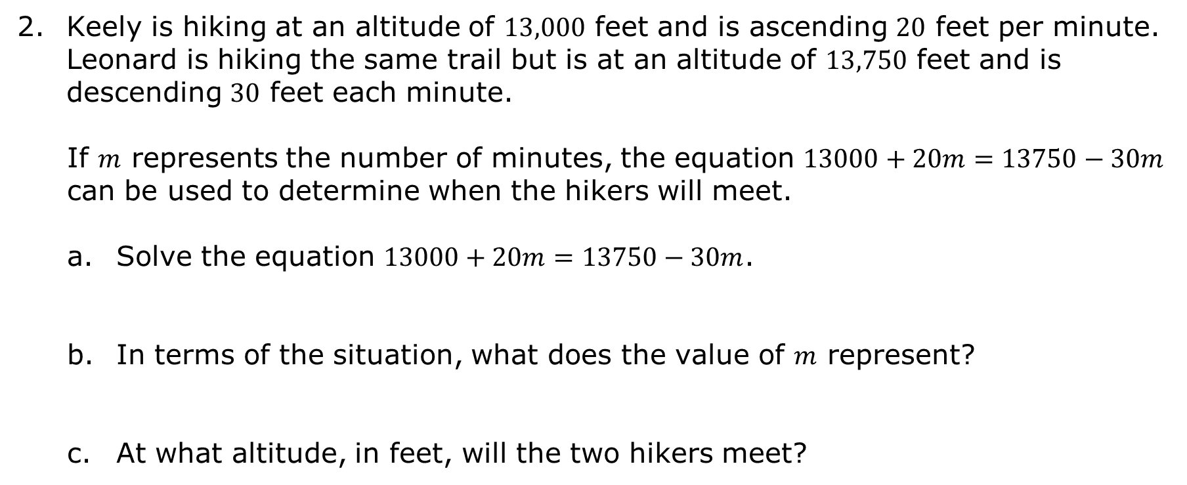
Keely is hiking at an altitude of $13,000$ feet and is ascending $20$ feet per minute. Leonard is hiking the same trail but is at an altitude of $13,750$ feet and is descending $30$ feet each minute.
If $m$ represents the number of minutes, the equation $13000+20m=13750−30m$ can be used to determine when the hikers will meet.
Solve the equation $13000+20m=13750−30m$.
In terms of the situation, what does the value of $m$ represent?
At what altitude, in feet, will the two hikers meet?
volume 2, pg. 29

Slide 16

Guided Practice
volume 2, pg. 29

Slide 17

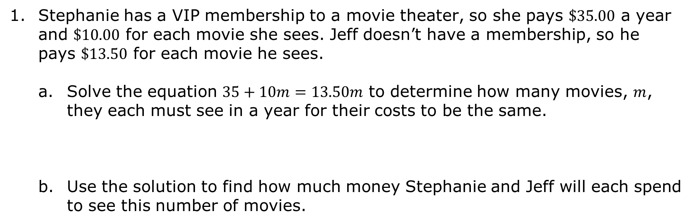
8.5.4 Guided Practice: Solving Real-World Equations with Variables on Both Sides
Stephanie has a VIP membership to a movie theater, so she pays $\$35.00$ a year and $\$10.00$ for each movie she sees. Jeff doesn’t have a membership, so he pays $\$13.50$ for each movie he sees.
Solve the equation $35+10m=13.50m$ to determine how many movies, $m$, they each must see in a year for their costs to be the same.
Use the solution to find how much money Stephanie and Jeff will each spend to see this number of movies.
volume 2, pg. 29

Slide 18

Wrap-Up
volume 2, pg. 30

Slide 19
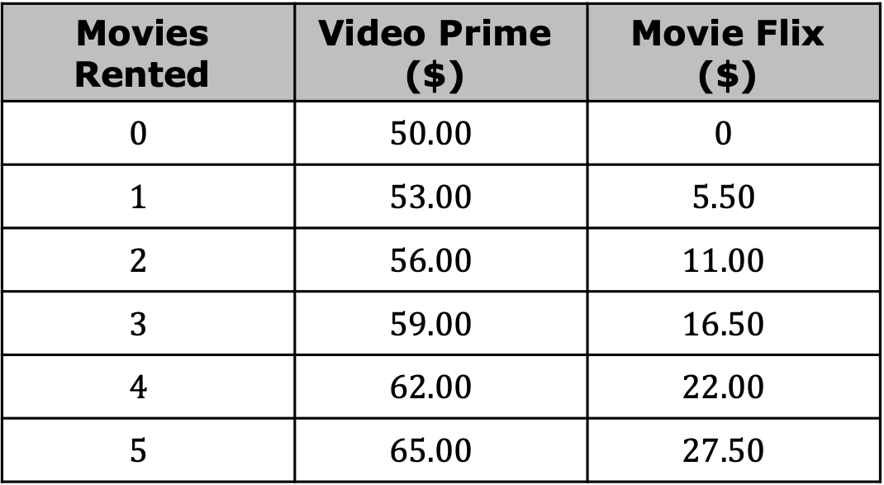
8.5.5 Wrap-Up: Ticket Out the Door
The cost for renting movies from two different online streaming platforms is shown in the table.
Movies Rented | Video Prime ($) | Movie Flix ($)
$$0$$ | $$50.00$$ | $$0$$
$$1$$ | $$53.00$$ | $$5.50$$
$$2$$ | $$56.00$$ | $$11.00$$
$$3$$ | $$59.00$$ | $$16.50$$
$$4$$ | $$62.00$$ | $$22.00$$
$$5$$ | $$65.00$$ | $$27.50$$
volume 2, pg. 30

Slide 20
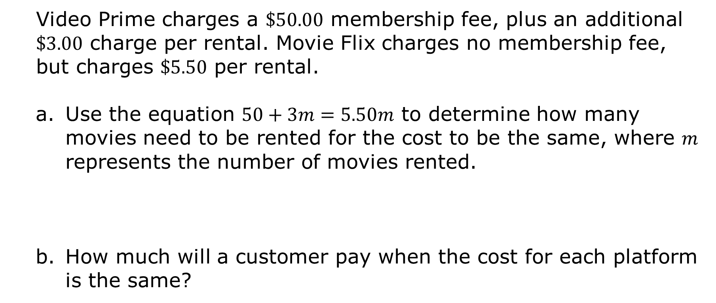
Video Prime charges a $\$50.00$ membership fee, plus an additional $\$3.00$ charge per rental. Movie Flix charges no membership fee, but charges $\$5.50$ per rental.
Use the equation $50+3m=5.50m$ to determine how many movies need to be rented for the cost to be the same, where $m$ represents the number of movies rented.
How much will a customer pay when the cost for each platform is the same?
volume 2, pg. 30

